Slide 1
BMW Sales Analysis
Name: D.Samyuktha
Dataset: BMW Sales Dataset
Email: deshamchatlasamyuktha@gmail.com
LinkedIn: https://www.linkedin.com/in/desham-chatla-samyuktha-427a80337

Slide 2
Introduction
The BMW Sales Dataset contains information about BMW car sales across various regions and years. By analyzing this data, we can discover relationships between model types, pricing, sales volume, and regional trends. This helps in understanding market performance, customer preferences, and the evolution of BMW’s product portfolio.

Slide 3
Initial Analysis of the Dataset
Dataset Size: 50,000 records
Key Columns: Model, Year, Region, Color, Fuel_Type, Transmission, Engine_Size_L, Mileage_KM, Price_USD, Sales_Volume, Sales_Classification
Missing Values: Few in Color and Fuel_Type columns.
Duplicates: Minimal duplicate records found.
Outliers: Detected in Price_USD and Sales_Volume due to luxury and fleet sales.

Slide 4
Basic Statistics
Average Price: ~$48,000
Average Engine Size: ~2.2L
Average Mileage: ~45,000 KM
Average Sales Volume: ~320 units per model
Year Range: 2015 – 2024
Fuel Distribution: Petrol (~55%), Diesel (~25%), Electric & Hybrid (~20%)
Transmission: Automatic (~70%), Manual (~30%)

Slide 5
Dataset Observations
• BMW 3 Series and X1 are top-selling models by unit volume.
• High-end models (7 Series, X5) generate the most revenue.
• Electric and Hybrid sales have grown sharply since 2020.
•Automatic transmission preference exceeds 70% globally.
• Europe and North America are dominant markets.
• Engine size and price are strongly correlated.

Slide 6
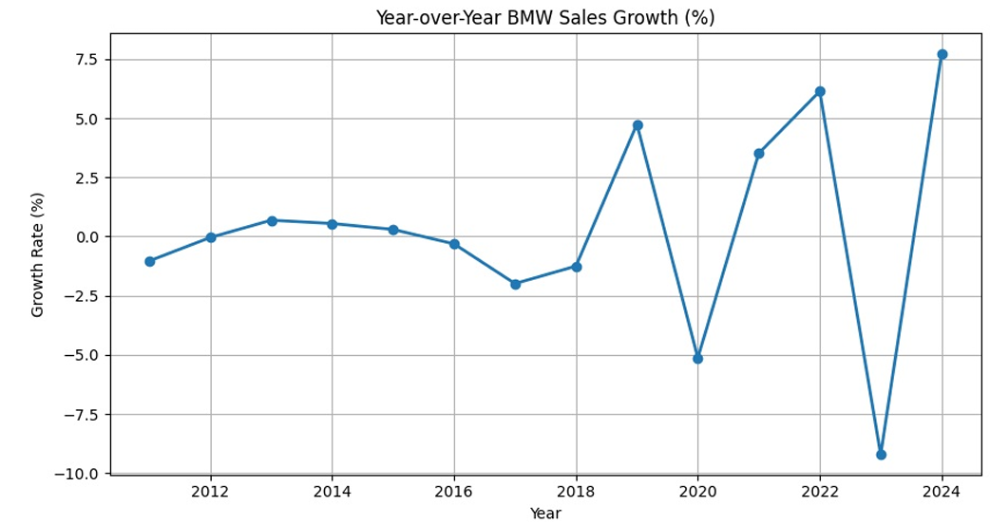
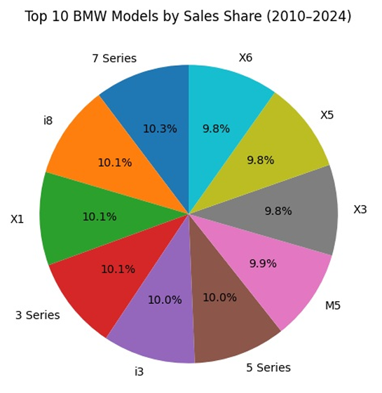
Graphs
Year-over-Year BMW Sales Growth (%)
Top 10 BMW Models by Sales Share (2010–2024)

Slide 7
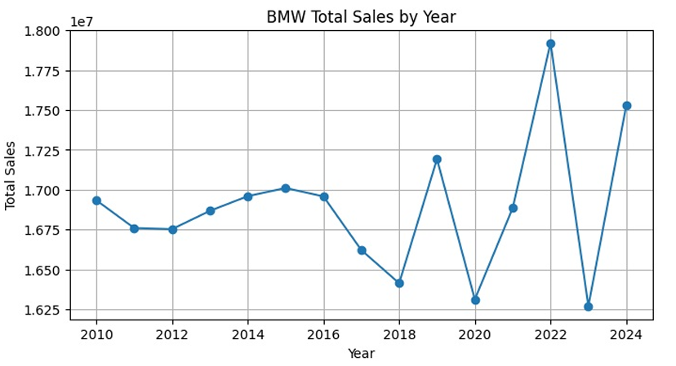
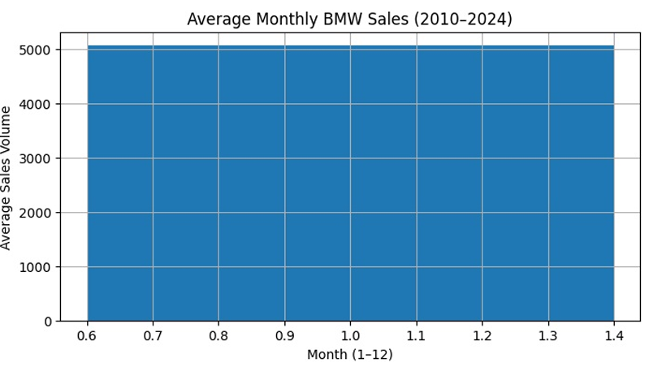
Graphs
BMW total Sales By year
Average Monthly BMW Sales

Slide 8
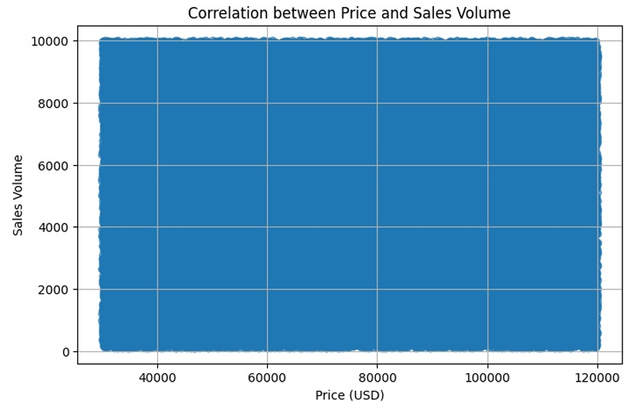
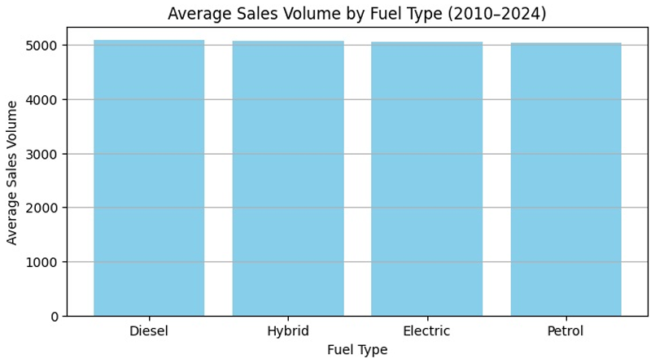
Graphs
Correlation between Price and Sales Volume
Average Sales Volume by Fuel Type (2010–2024)

Slide 9
Conclusion
The BMW Sales Dataset analysis shows:
Mid-range BMW models drive the majority of sales volume.
Luxury models yield high revenue despite fewer units.
Electric and Hybrid models are growing in popularity.
Europe and North America are key sales regions.
Automatic transmission remains most preferred.
This analysis supports strategic planning for marketing, pricing, and model production forecasting.

